Slide 1
Introduction
EPA is overseeing the RI/FS for the Rolling Knolls Landfill being conducted by several companies under a 2005 administrative order on consent
EPA has been providing CAG members with updates on current status of the RI/FS
So where does USFWS and the Refuge fit in?

Slide 2
Our Role is a Bit Unique…
Neighbor/Community Member
Refuge/Wilderness Area Manager
Natural Resource Trustee
Potentially Responsible Party
Photo courtesy of GQ

Slide 3
Why is part of the landfill on the Refuge?
Late 1950s – Port Authority of NY/NJ wanted to develop area into a major regional airport; several opposition organizations formed
1960 – North American Wildlife Federation formed the Great Swamp Committee
Mid 1960s – 2,600 acres purchased and donated to US to create the Great Swamp National Wildlife Refuge
Included a portion of the Rolling Knolls landfill and a deed condition that allowed sanitary landfill operations to continue in that area through 1968
Conservation groups sought additional protection for the donated lands, which were designated a National Wilderness Area in 1968
With this designation came a requirement to return the lands to a more natural state and many roads, houses, and other works of man were removed to enhance wildlife habitat

Slide 4
A little about us….
50 years of combined experience in the Superfund cleanup process
Have particular expertise in evaluating risks to ecological receptors/resources
Have expertise in Refuge ecosystems and how they support wildlife and other biological resources
Responsible for protecting the Refuge and Wilderness Area for the benefit of the community and future generations

Slide 5
Open Communication
2015 - Refuge initiated informal meetings with the Miele Trust and the companies performing the RI/FS
Met regularly onsite (usually 3 times per year)
Meetings increased communication and discussion of site issues related to the Wilderness Area
Important that the FS alternatives evaluated and the remedy selected address the Wilderness Area
FWS found these meetings very constructive and beneficial
An outgrowth of these meeting was a discussion of important wilderness and community-friendly considerations

Slide 6
Important Considerations
Wilderness areas “shall be administered for the use and enjoyment of the American people in such manner as will leave them unimpaired for future use and enjoyment as wilderness” (Wilderness Act, 16 U.S.C. § 1131(a))
Onsite native clay is available to cap/contain landfill waste
Less truck traffic, emissions and disruption to local community
Potentially lower costs
Successfully implemented at two other sites on the Refuge
Additional grassland habitat established on the landfill cap will benefit wildlife
Future use of site for passive recreation area with trails, wildlife viewing opportunities and fishing ponds will benefit the community

Slide 7
Asbestos Dump OU3

Slide 8
Harding Landfill

Slide 9
FWS involvement in RI/FS Process so far
Rolling Knolls Landfill was listed on the NPL in 2003; proximity to the Refuge/Wilderness Area and impact to wildlife important considerations
FWS involvement was limited during RI field work
EPA negotiated an agreement with several companies for performance of the RI/FS in 2005
RI field work was performed in several phases beginning in 2007 and ending in 2015
FWS involvement in RI/FS process increased as documents began to be drafted
Draft RI/FS documents have been provided to FWS for comment

Slide 10
Based on FWS review to date …
FWS has concerns with FS alternatives that do not fully cap/contain the landfill waste
RI data adequate to support capping, but not to allow waste to remain uncapped/uncontained
≈ 1 surface soil sample per acre
Limited subsurface soil data
Limited data collected in Refuge
Soil standards used to identify COCs are human health based
Impacts to the Wilderness Area from uncapped/uncontained waste have not been fully evaluated
Alternatives evaluated in draft FS focused on human health risks rather than risks to wildlife, which are of critical concern to FWS in managing the Refuge

Slide 11
FWS comments on draft FS
FWS has provided comments to EPA on draft versions of the FS
Only one alternative in the draft FS would require all landfill waste to be capped; this alternative proposes capping the landfill “as is” with offsite material
All other proposed alternatives would allow uncapped landfill waste to remain on and adjacent to the Wilderness Area

Slide 12
FWS has recommended that …
The FS evaluate how each alternative will address the wilderness character of the Refuge Wilderness Area under the Wilderness Act
The FS evaluate additional alternatives that would remove or cap the waste in the Wilderness Area
FWS and EPA work together to ensure the FS issued for public comment addresses these concerns

Slide 13
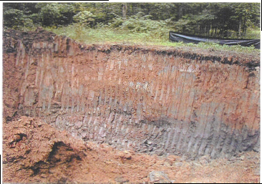
As a practical matter …
Three possible alternatives to address the wilderness character of the Refuge include:
Remove waste and contaminated soil/sediment from the Wilderness Area and establish wetland vegetation; consolidate removed material on private portion of the landfill and cap with clay available onsite; establish native warm season grasses/meadow mix on cap
Cap entire landfill; establish native warm season grasses/meadow mix on cap
Cap the waste on the Wilderness Area; establish native warm season grasses/ meadow mix on cap; install engineering controls to prevent the migration of contaminants from any landfill area not capped or contained

Slide 14
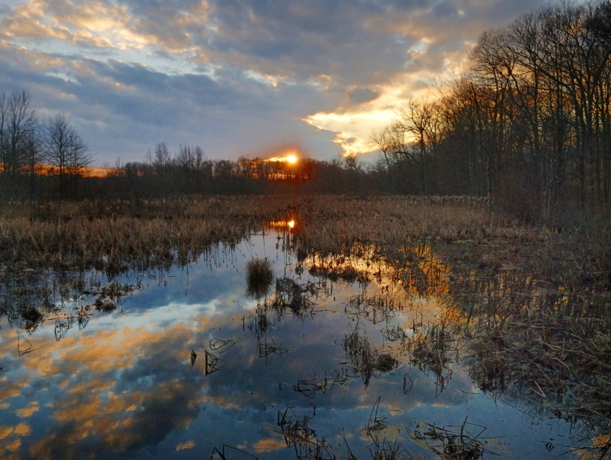
Wilderness Area
Wilderness areas “shall be administered for the use and enjoyment of the American people in such manner as will leave them unimpaired for future use and enjoyment as wilderness…”
Wilderness Act, 16 U.S.C. § 1131(a)

