Slide 1
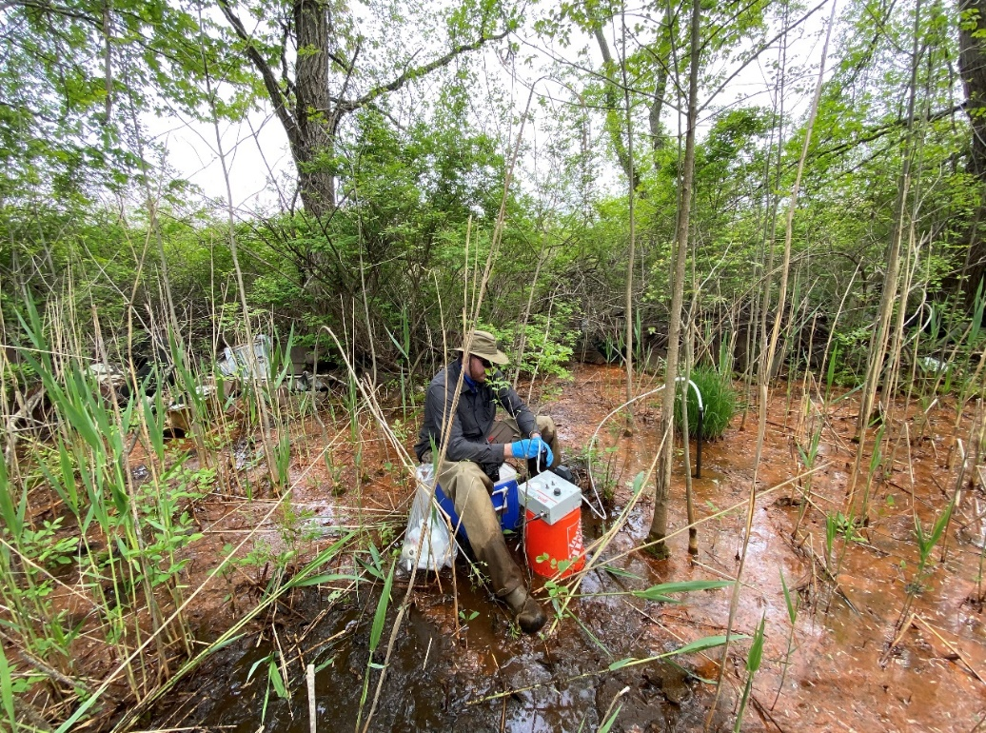
Rolling Knolls Landfill Data Gaps Investigation

Slide 2
Rolling Knolls Landfill-Data Gap Investigation
FWS identified several areas where additional data was needed to more fully understand the landfill.
Spatial gaps in surface soil and sediment sampling on Refuge.
Limited sub-surface samples in waste pile.
Interface between waste, surface water, shallow groundwater and sediment poorly understood.
Other field-based observations based on a more thorough look at Refuge owned part of the landfill.

Slide 3
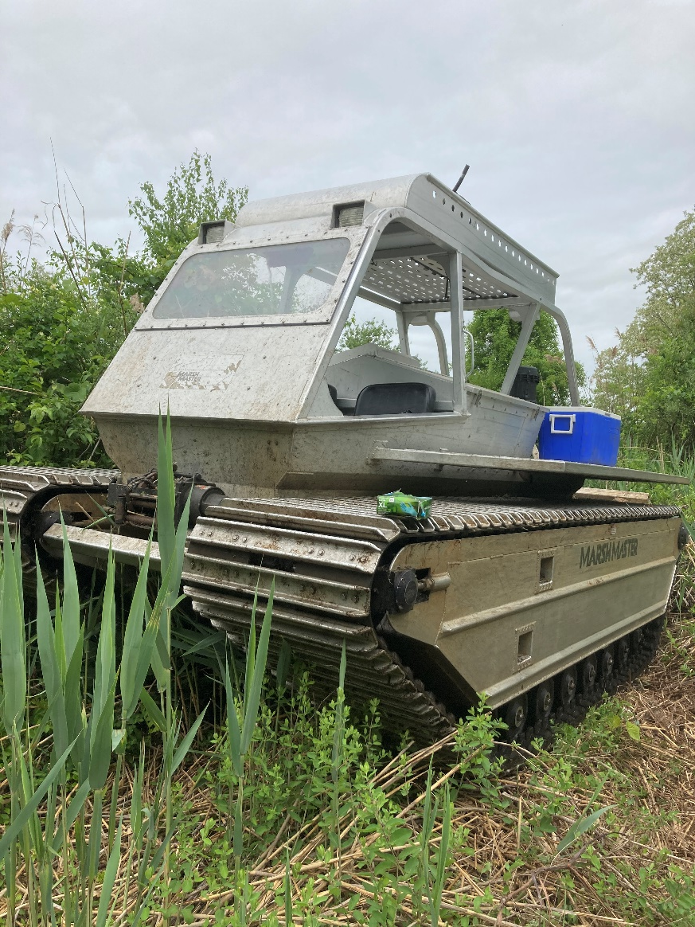
Rolling Knolls Landfill-Data Gap Investigation
Total approximate cost: $750,000 via DOI’s Central Hazardous Material Fund
Field collection of additional surface and subsurface soil, sediment, surface water, pore water (to address data gaps) and geotechnical samples (to verify clay layer) on Refuge portion of the site.
Field work completed in May 2021

Slide 4
Investigation Goals
Address data gaps through the collection and analysis of additional sediment, surface water, pore water, surface soils, and subsurface soils in areas identified where sufficient data was lacking.
Gain a better understanding of the leaching potential of the landfill waste and the fate and transport of redox sensitive metals. (adding to empirical observations of landfill leaching).
Collection of select borings to provide geotechnical data to better inform and guide the selection of an appropriate and protective remedy.
Collect other field-based observations about the nature of the landfill (i.e., presence and distribution of drums).
Share results with EPA and the PRP Group with the intent to supplement existing datasets and aide in the development of a remedial alternative.

Slide 5
Rolling Knolls Landfill-Data Gap Investigation
31 surface soil samples
55 subsurface soil samples
47 pore water samples
21 sediment samples
10 surface water samples

Slide 6
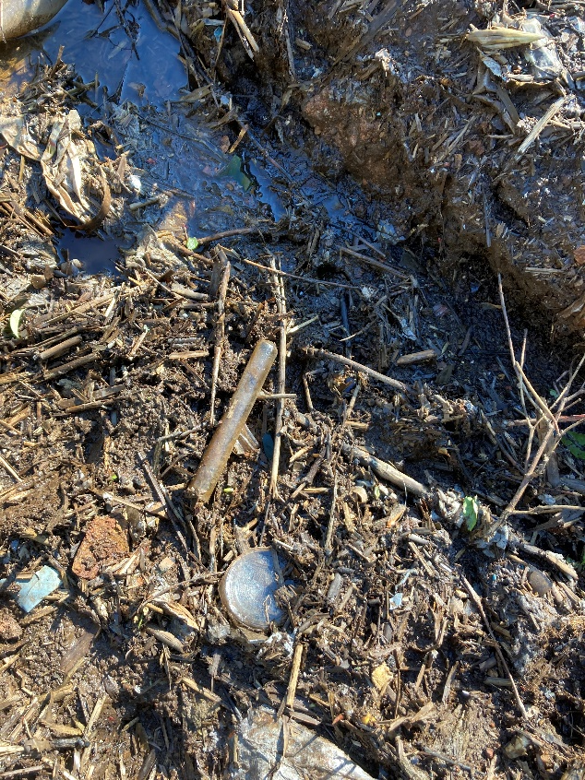
Field Observations
Visual evidence of widespread hazardous substances – mixed municipal and industrial waste throughout (hospital waste, electronics, etc.)
Numerous drum carcasses observed throughout the on-Refuge study area.
Active release of landfill leachate throughout the site, mostly along the eastern and southern portions of the waste pile onto the Refuge.

Slide 7
RI Soil Sample Locations

Slide 8
FWS Soil Sample Locations

Slide 9
RI Sediment and Surface Water Locations

Slide 10
Sediment Sample Locations

Slide 11
Surface Water and Pore Water Sample Locations

Slide 12
Investigation Results
Widespread contamination of constituents typically not associated with household waste (e.g., PCBs, lead, cadmium, and mercury).
Detections of several per- and polyfluoroalkyl substances (PFAS) compounds.
AVS-SEM data suggest bioavailability/toxicity of metals to benthic organisms.
Active releases of leachate throughout the study area.

Slide 13
Investigation Results
Numerous exceedances of screening criteria noted for all media.
Geochemical analysis confirmed redox conditions that facilitate the fate and transport of constituents within the landfill leachate.
Geochemical conditions at the landfill have significantly increased the mobility of metals.
Results of geotechnical evaluation verify thick clay strata underlying landfill and indicate is suitable for use in cap construction.

Slide 14
Investigation Results
Data indicate much more than just random “hotspots”.
Instead of localized “hotspots” as the RI and FS suggest, elevated levels of several constituents are ubiquitous throughout the study area.
“Fits” well with field observations (e.g., widespread evidence of industrial waste, active leaching, etc.)
Surface soils samples in red denote PCB and/or dioxin exceedances of screening criteria

Slide 15
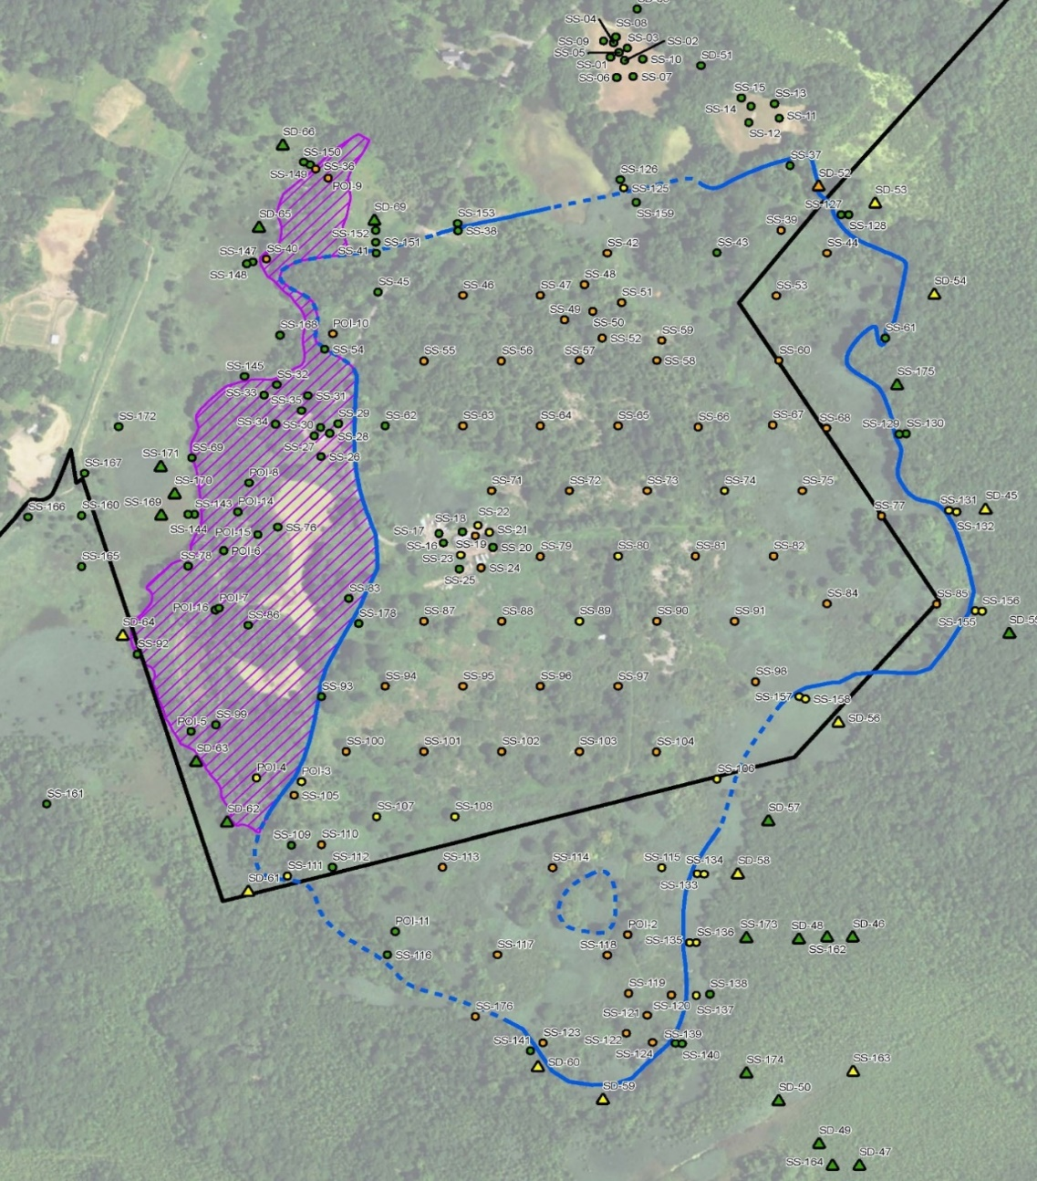
PCB Exceedances as Shown in the RI
The FS suggests household waste and municipal waste is segregated at the landfill.
Distribution of total PCB’s as found during the remedial investigation shows this to not be accurate

Slide 16
Data Gaps-Addressed?
Additional surficial contamination on the Refuge identified.
Vertical extent of contamination is widespread as expected.
Areas of the landfill where active leaching is occurring onto the Refuge.
Geochemical conditions present do play a role in the transport and bioavailability of metals.
Widespread evidence of industrial waste disposal.

Slide 17
Questions/Discussion

